Slide 1
Vivify Academy

Slide 3
Ponavljanje
Boundary testing
Equivalence class partitioning
Decision table
State transitioning
Error guessing

Slide 4
Fundamentals of testing
Vivify Academy

Slide 5
Week overview
Fundamentals of testing
Test Cases

Slide 6
What is a Test Case?
A Test Case is defined as a set of actions executed to verify a particular feature or functionality of the software application. A test case is an indispensable component of the Software Testing LifeCycle that helps validate the AUT (Application Under Test).

Slide 7
Test Scenario Vs Test Case
Test Scenario Vs Test Case
Test scenarios are rather vague and cover a wide range of possibilities. Testing is all about being very specific.
For a Test Scenario: Check Login Functionality there many possible test cases are:
Test Case 1: Check results on entering valid User Id & Password
Test Case 2: Check results on entering Invalid User ID & Password
Test Case 3: Check response when a User ID is Empty & Login Button is pressed, and many more

Slide 8
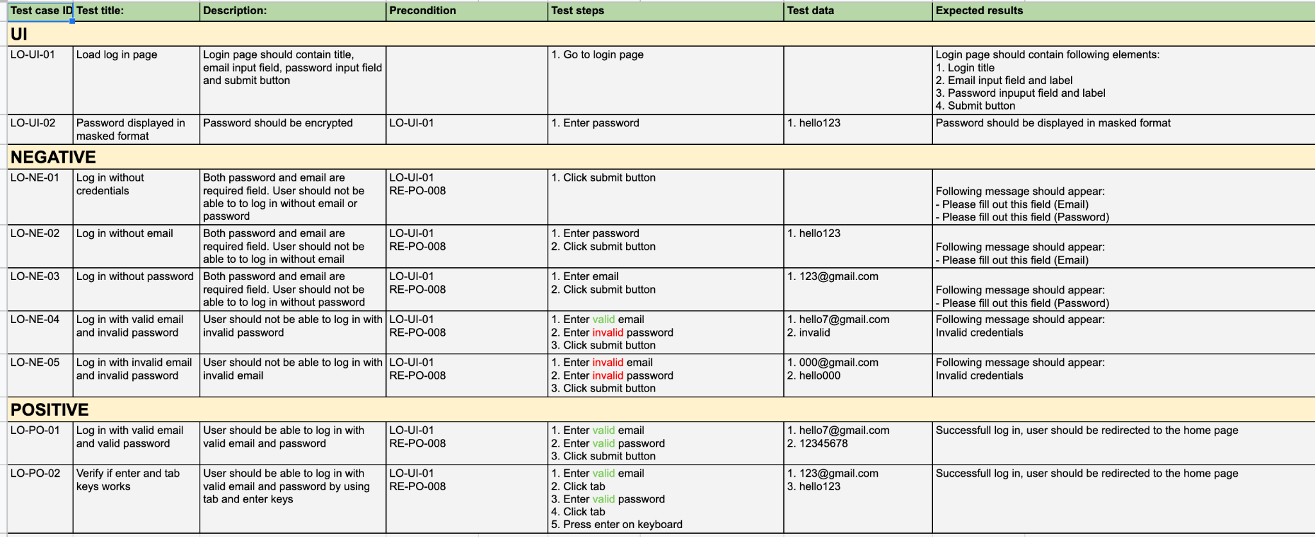

Slide 11
Write test cases
Application:
https://gallery-app.vivifyideas.com/api/auth/login

Slide 12
Vezba
Napisite test casove za register i login u formularu za test casove

